Slide 1
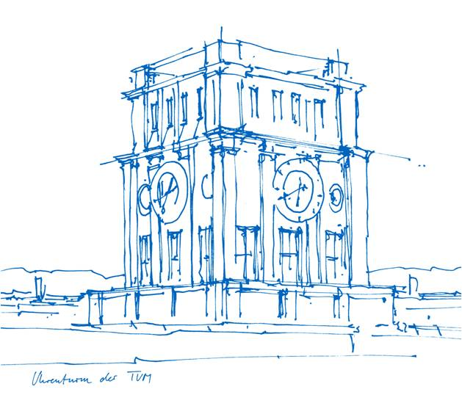
HospiChef
Abdelrahman Salem, Berkay Ugur Senocak
11.09.2023
Entrepreneurship Research Institute
Technische Universität München

Slide 2


Team
Abdelrahman Salem
Frontend Developer
Berkay Ugur Senocak
Backend/Data Science

Slide 3
AGENDA
Kitchen Feedback
Introduction
Preparation
Implementation
Patient App
Management Dashboard
Demand Forecasting
Definition
Why it is important?
Demand forecasting for HospiChef
Requirements
Suitable techniques
Implementation
Conclusion
Q&A

Slide 4
Feedback for Kitchen

Slide 5
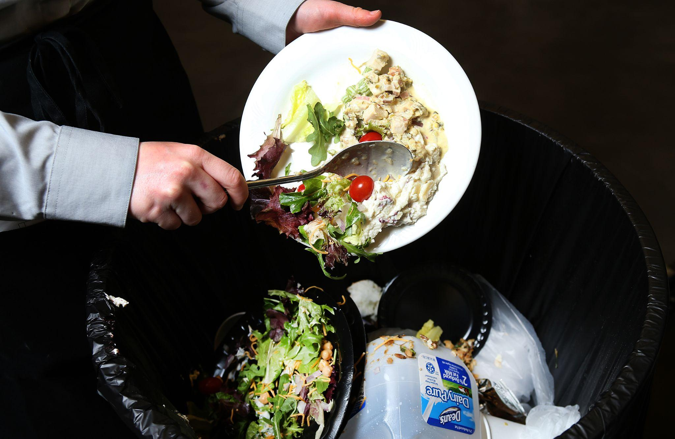

Objective

Slide 6
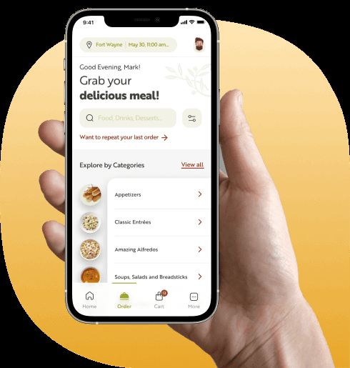

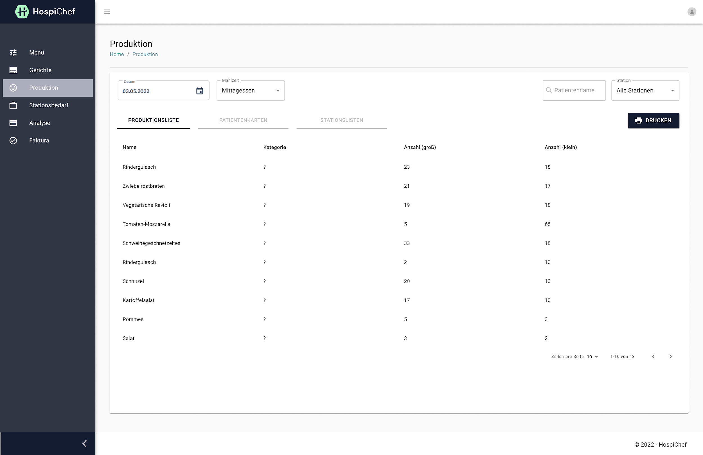
Available solutions by HospiChef
Patient App 2
Dashboard management

Slide 7
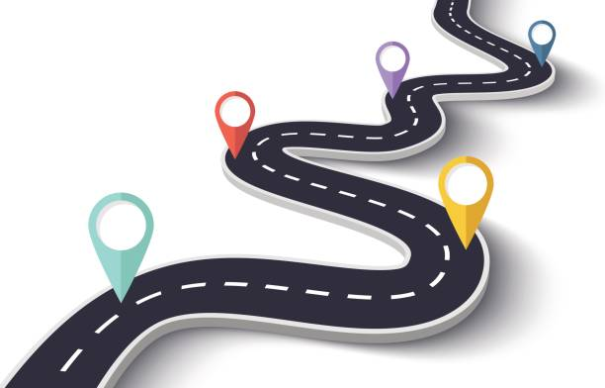
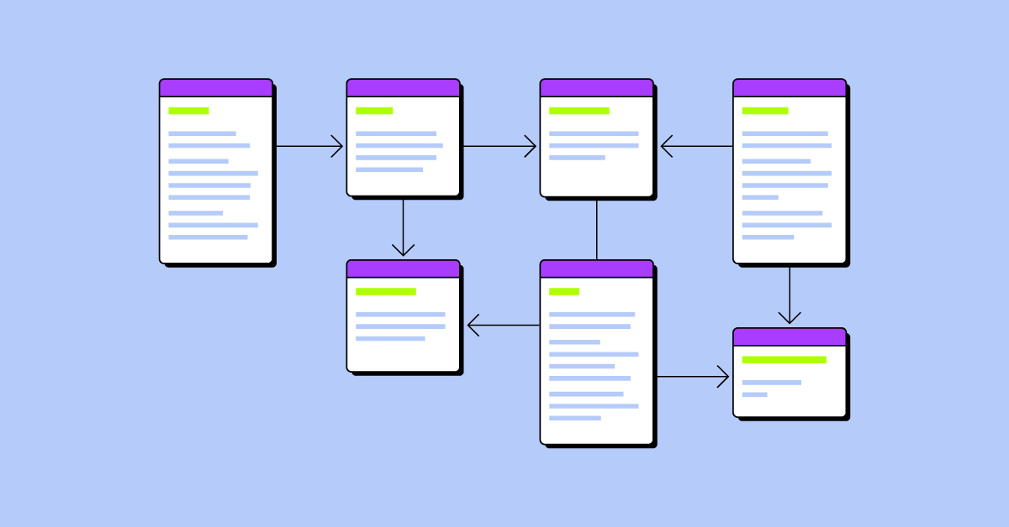

Preparation
Road map
Design database Model
Views and Designs

Slide 8
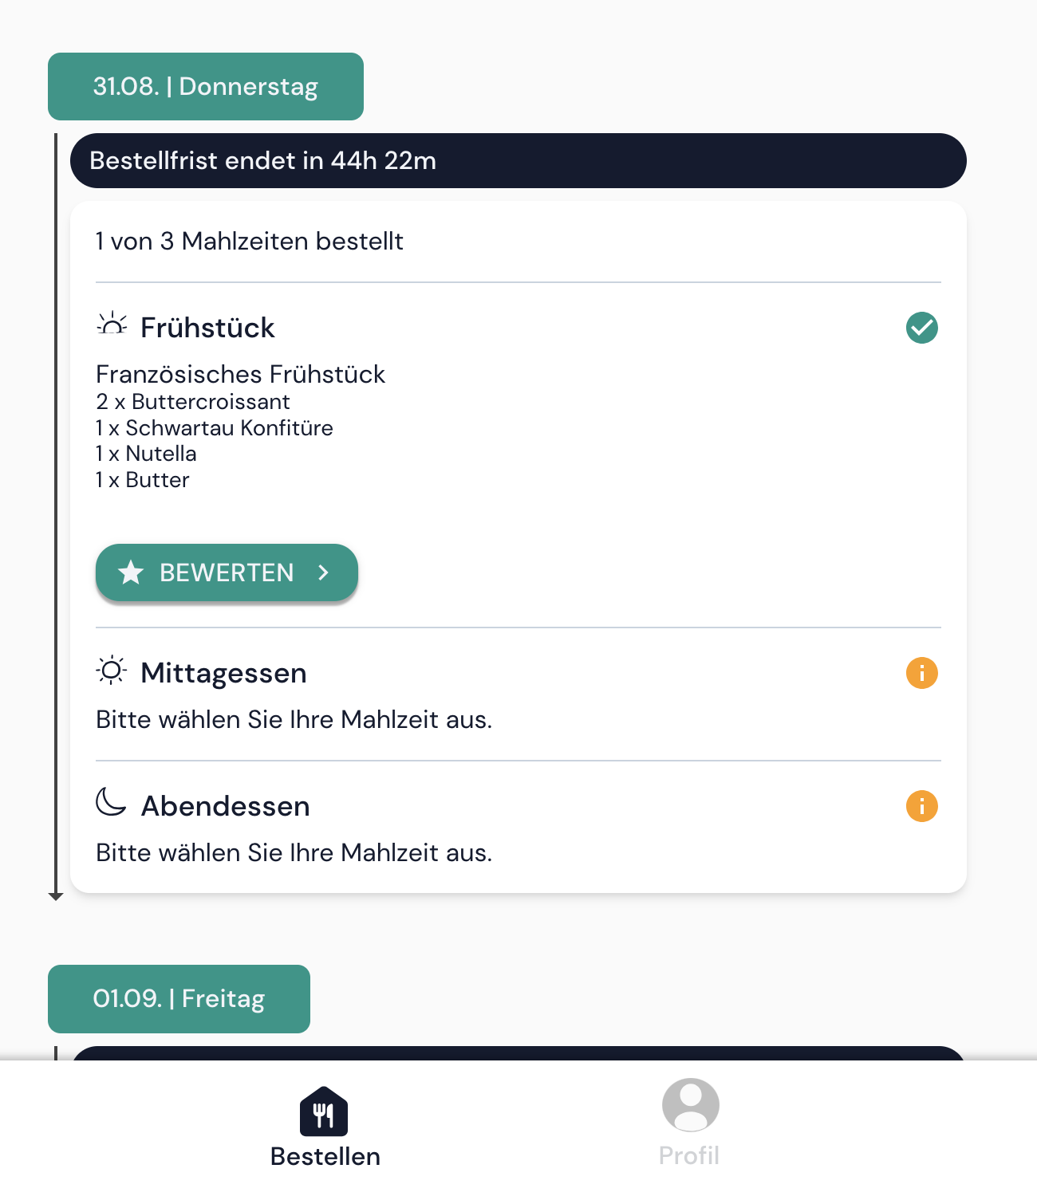
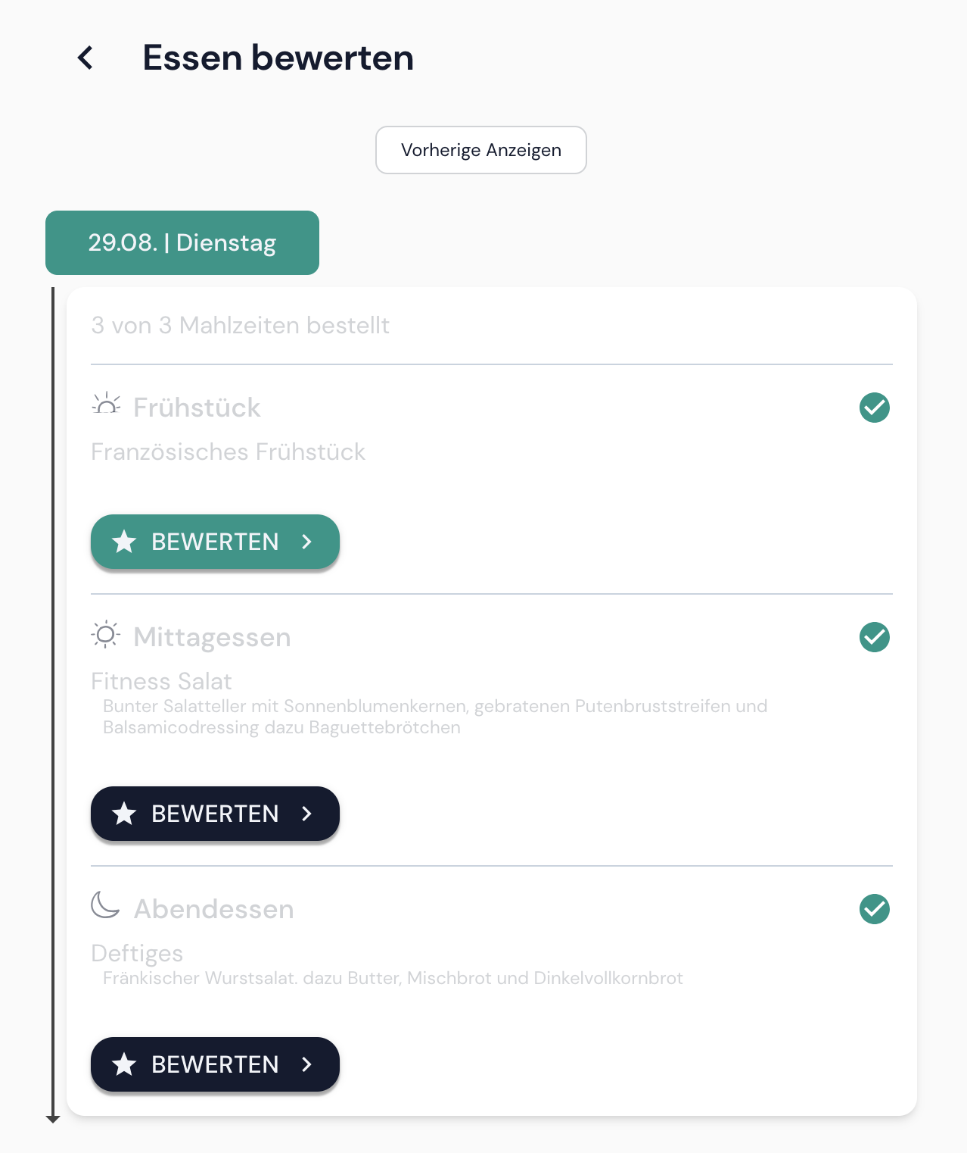
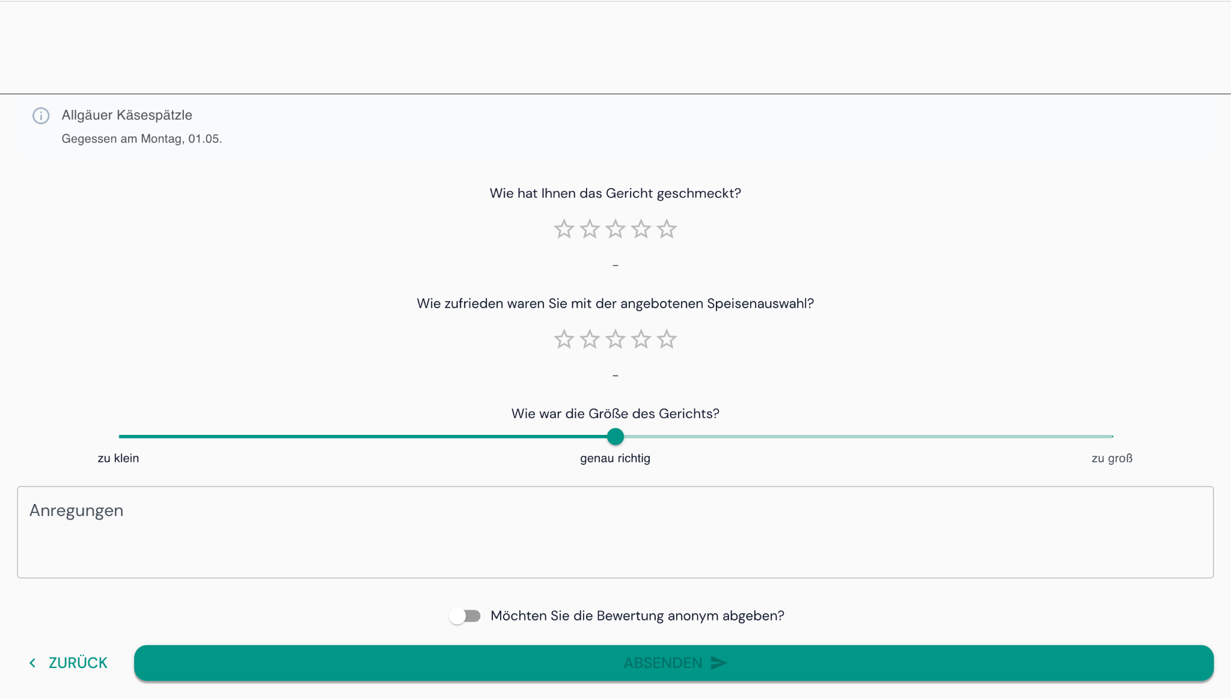
Implementation
Patient App

Slide 9
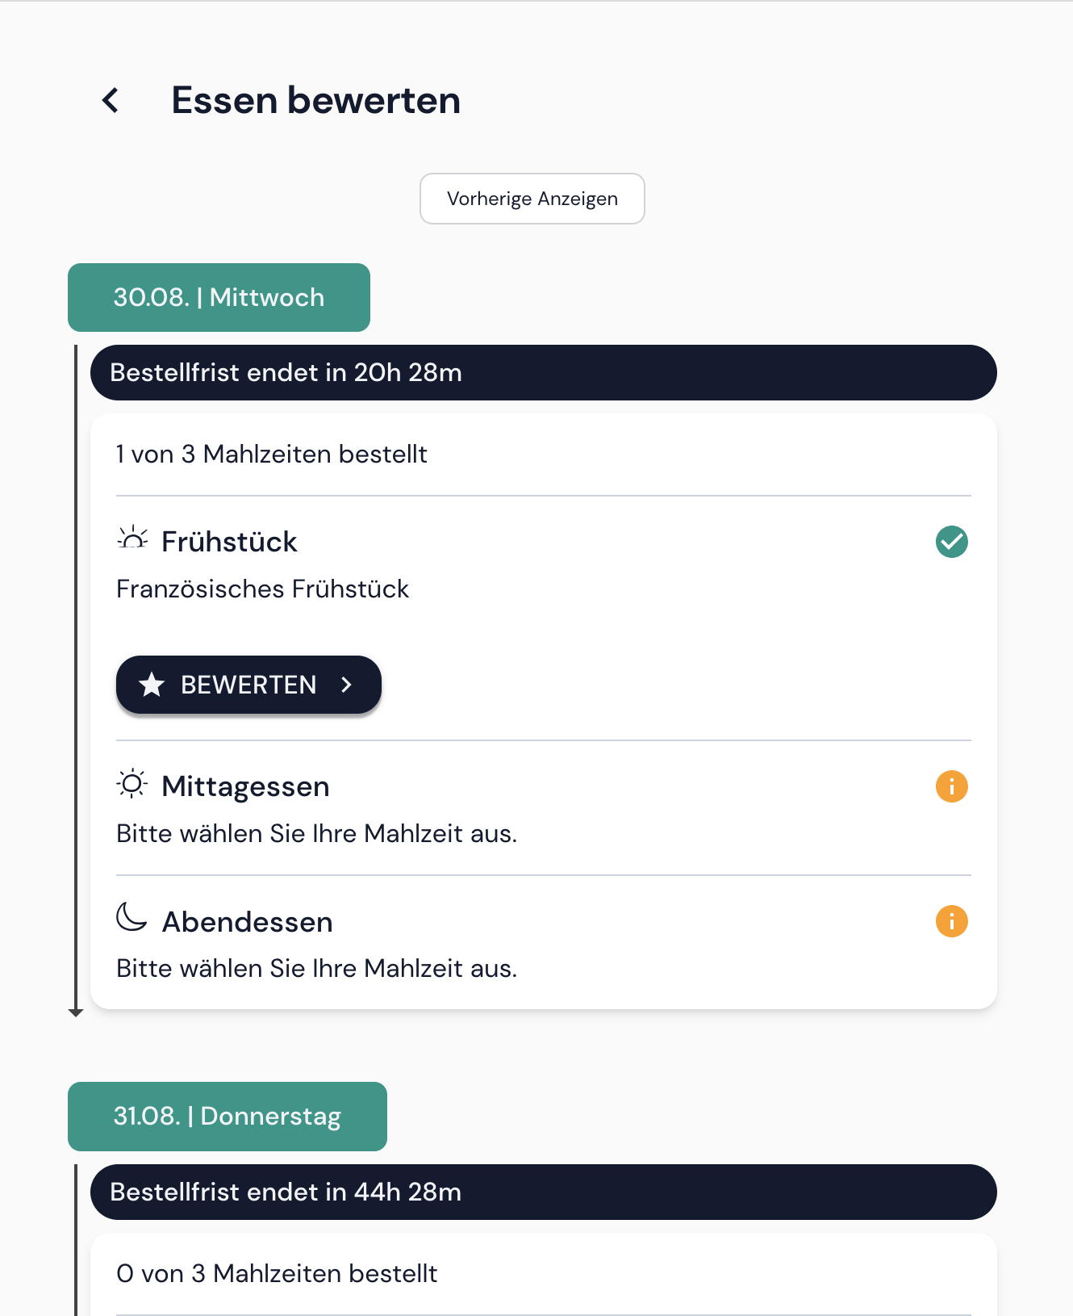
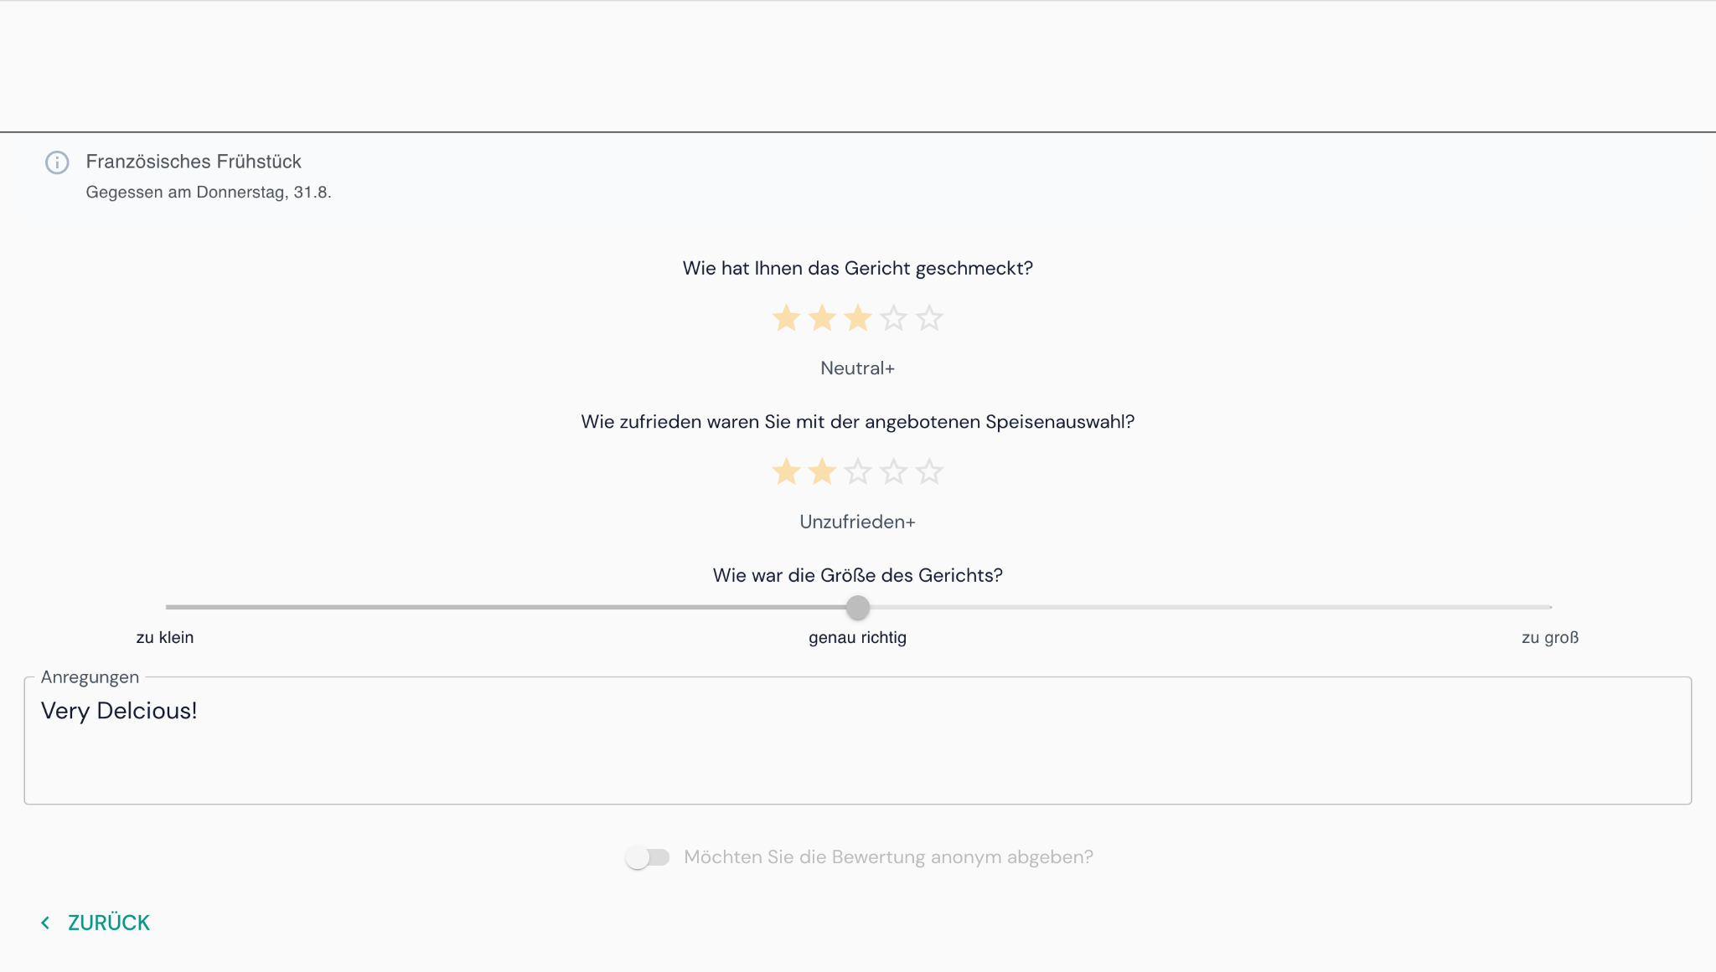
Implementation
Patient App

Slide 10
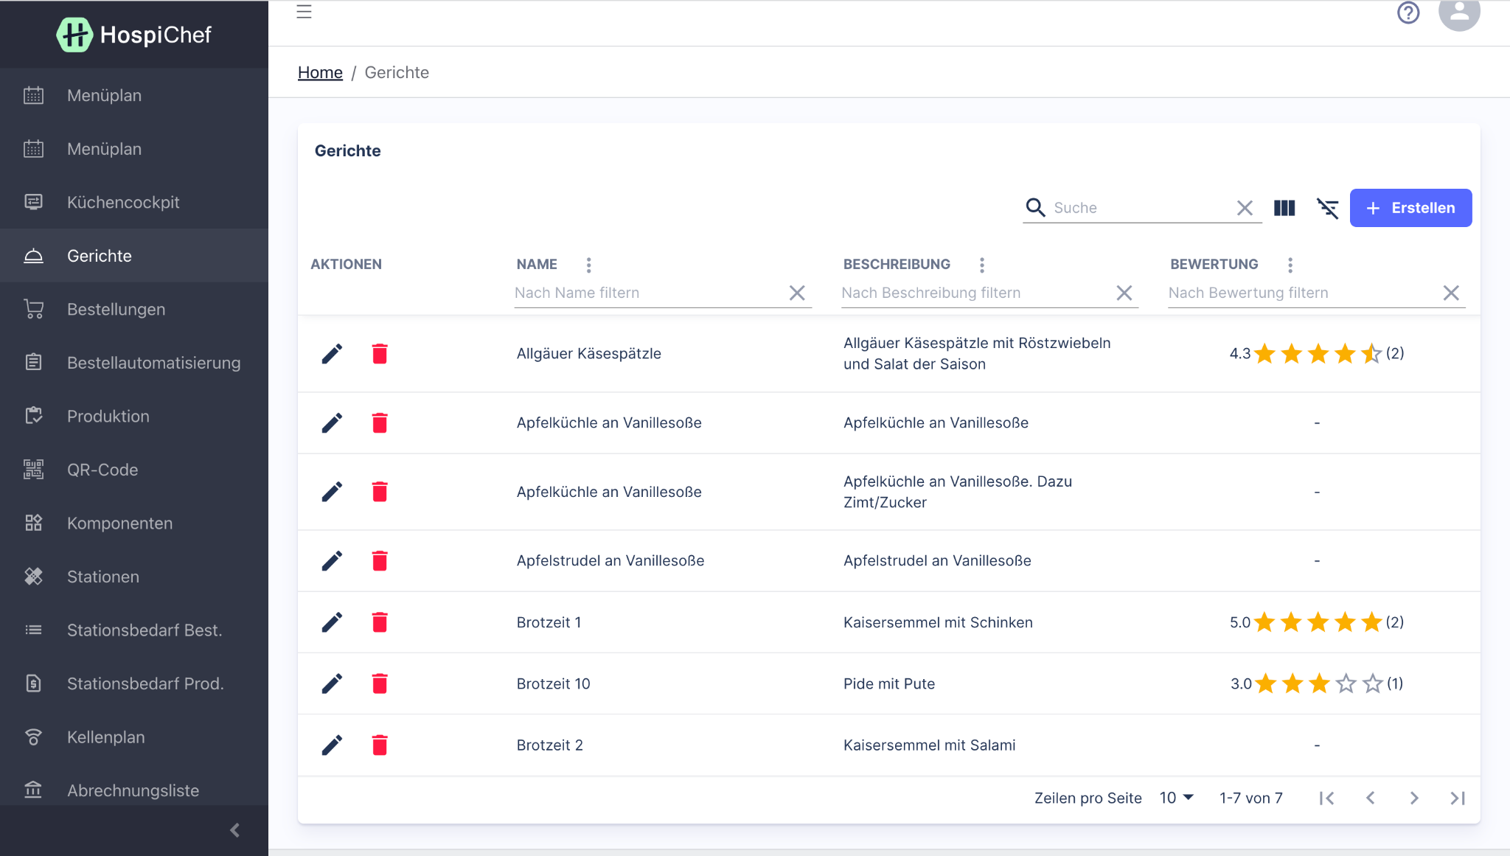
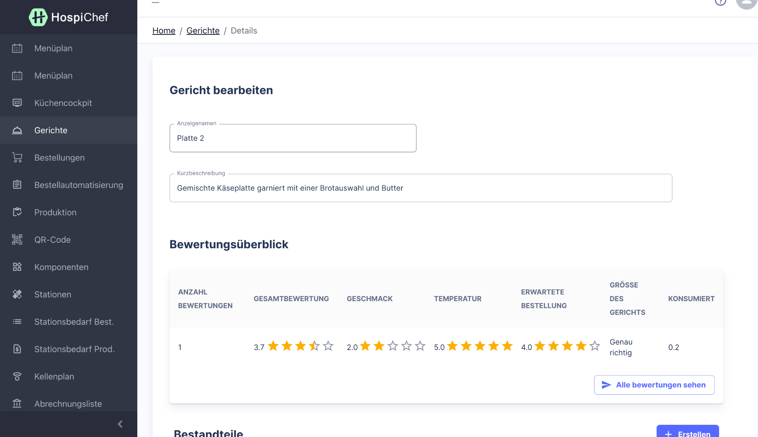
Implementation
Dashboard

Slide 11
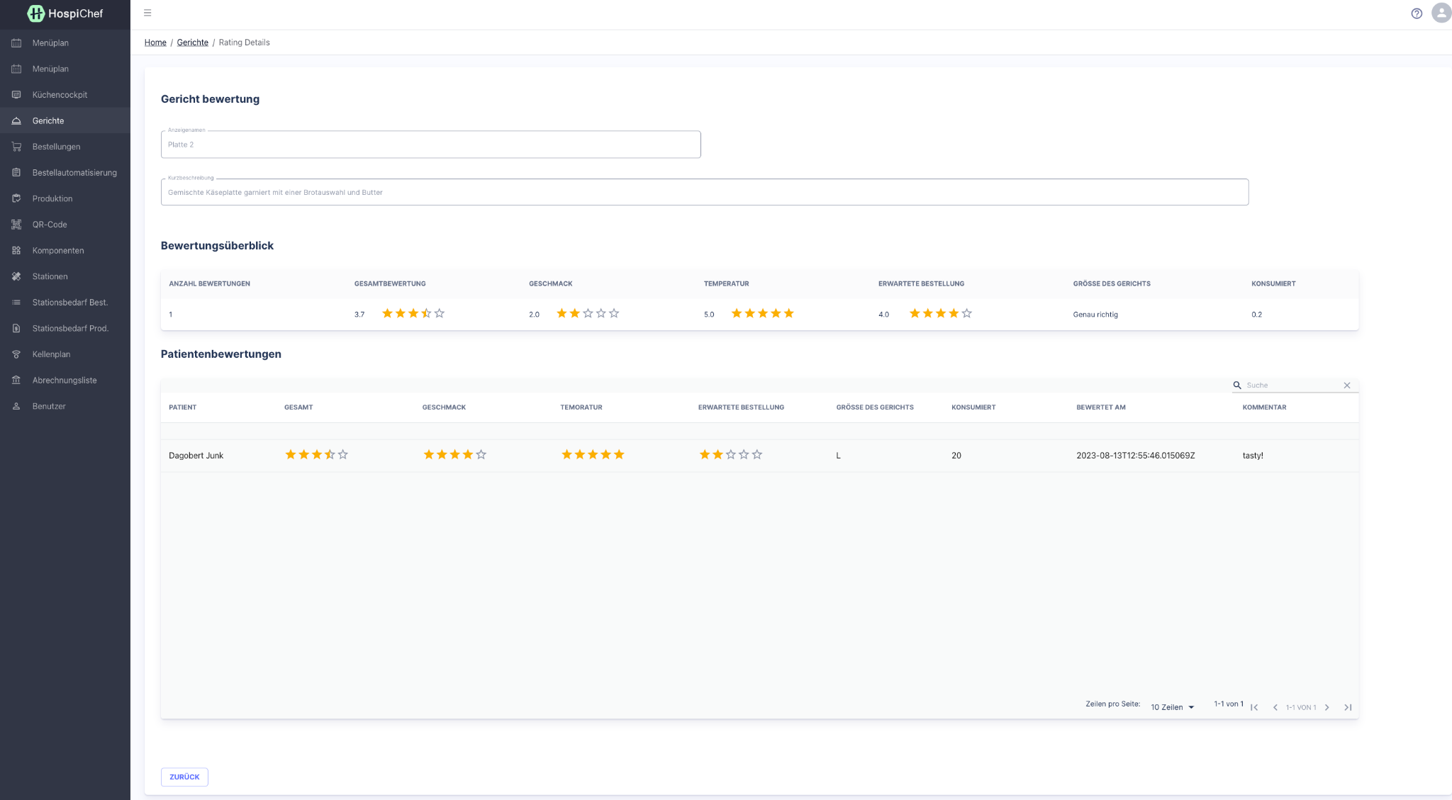
Implementation
Dashboard

Slide 12
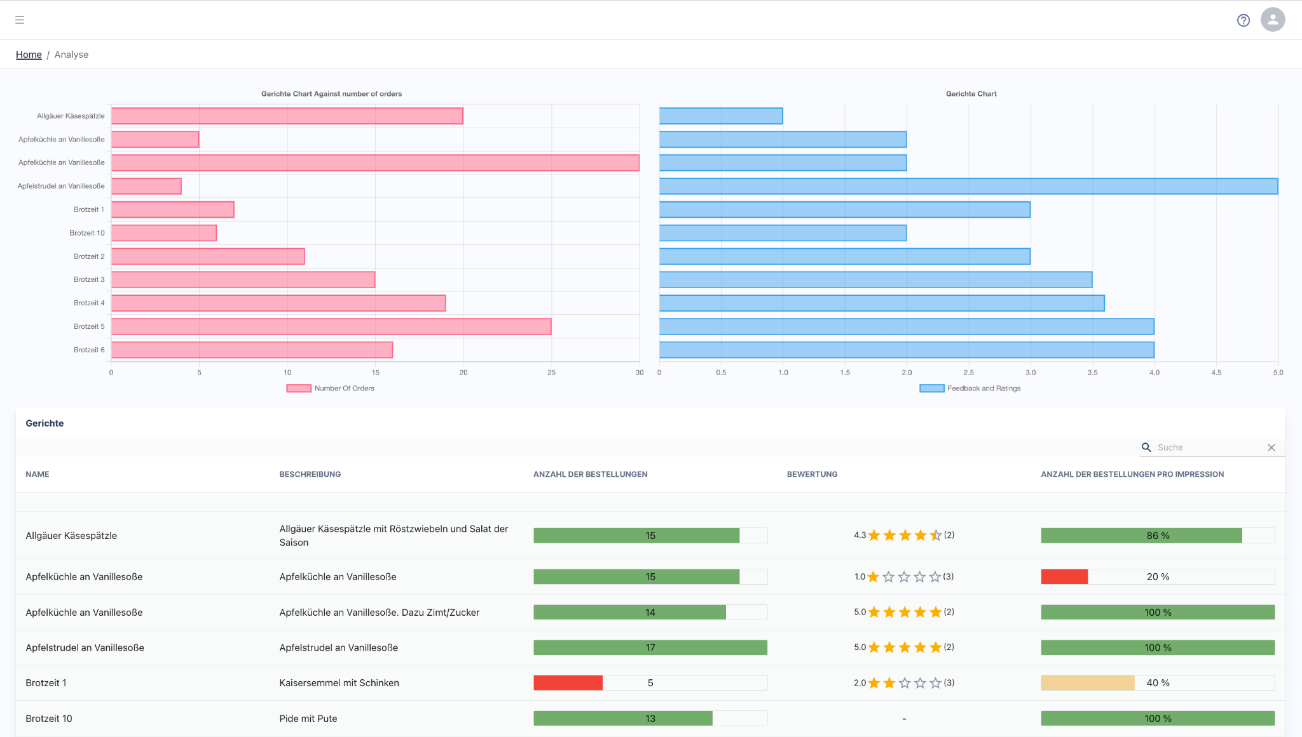
Implementation
Dashboard

Slide 13
Functionalities added to HospiChef base

Slide 14
Demand Forecasting

Slide 15
What is demand forecasting?
Demand forecasting predicts future consumer demand using past data.
It helps businesses make informed supply decisions and anticipate future sales and revenue.
Optimization of inventories is possible through demand forecasting.
Demand managers can use it for various decisions, from inventory planning to meeting consumer expectations based on past sales data.

Slide 16
Why is it important?
Demand forecasting helps companies predict the future, aiding in financial planning.
It is crucial for managing risks in various industries but can be complex, especially with quantitative analysis.
Understanding consumer needs is essential for efficient business operations and market responsiveness.
Efficient demand forecasting can lead to benefits like waste reduction, resource optimization, and increased sales and income.

Slide 17
Demand forecasting at HospiChef
One of the problems HospiChef addresses is that the waste of hospital food
In the software HospiChef is providing, options for menu planning are available
E.g. A hospital can make their menu plans for the upcoming X months and repeat it for the entire year
This case forms a good baseline for demand forecasting problem, as there is historical data that can be used to predict the future

Slide 18
Requirements
Predictions should be:
Displayed to hospital staff so that they can order just enough
Able to be partitioned for specific time frames (tomorrow, next week etc.)
Paired with confidence of the prediction (shorter time period = higher confidence)
Able to provide the contributing parameters and how the prediction is formed

Slide 19
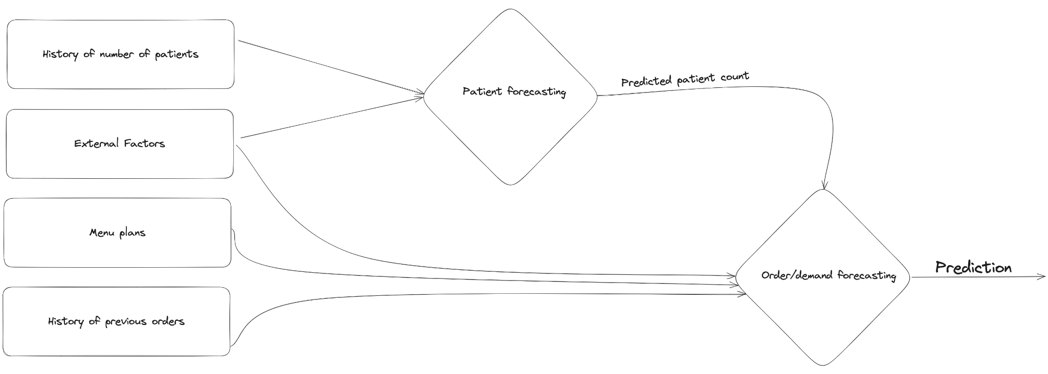
Pipeline

Slide 20
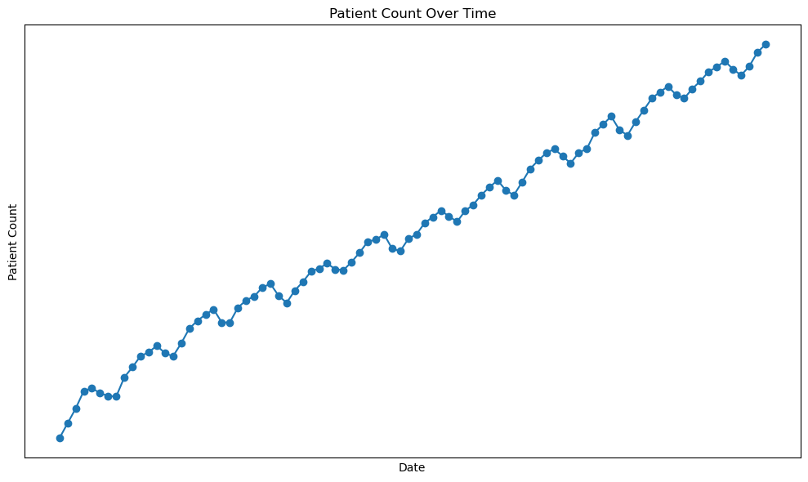
Historical data of patient count

Slide 21
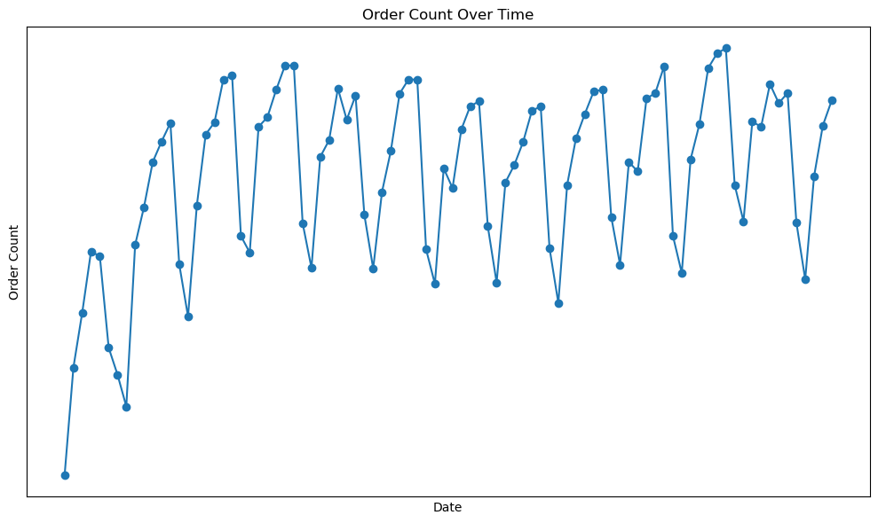
Historical data of order count

Slide 22
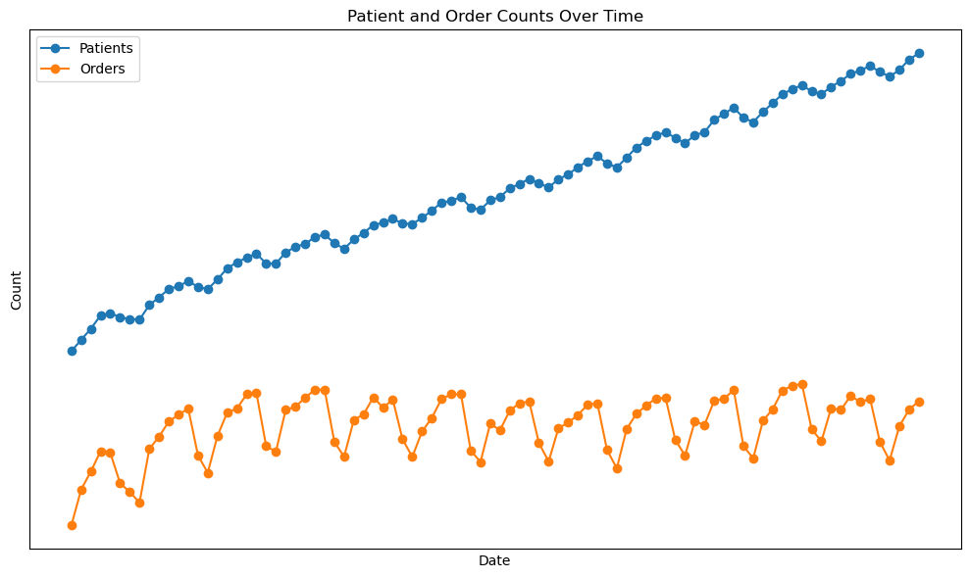
Correlation

Slide 23
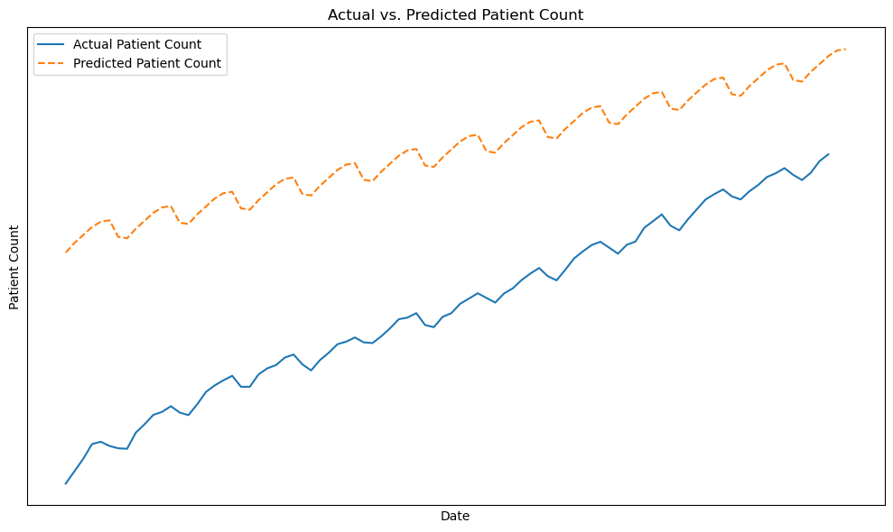
Forecasting

Slide 24
Conclusion
It makes sense to divide the model in a way that each model focuses on a specific time (i.e., Breakfast, Lunch, Dinner) so that the predictions are most likely to be more accurate.
After acquiring predictions from the model, using some rules (i.e., customer-specific patterns, or external parameters such as holiday) the predictions might be tweaked.
Instead of using discrete space, migrating into a continuous space, and working with probability distributions makes more sense, i.e., provides a confidence interval.
Try to overcast instead of undercasting so that no one stays hungry.

Slide 25
Thank you!

Slide 26
Q & A

